Slide 1


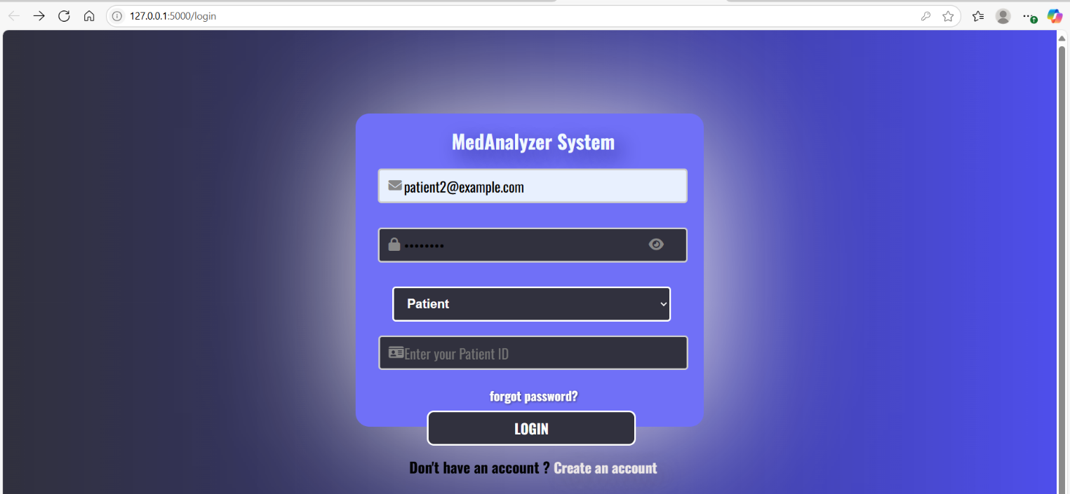
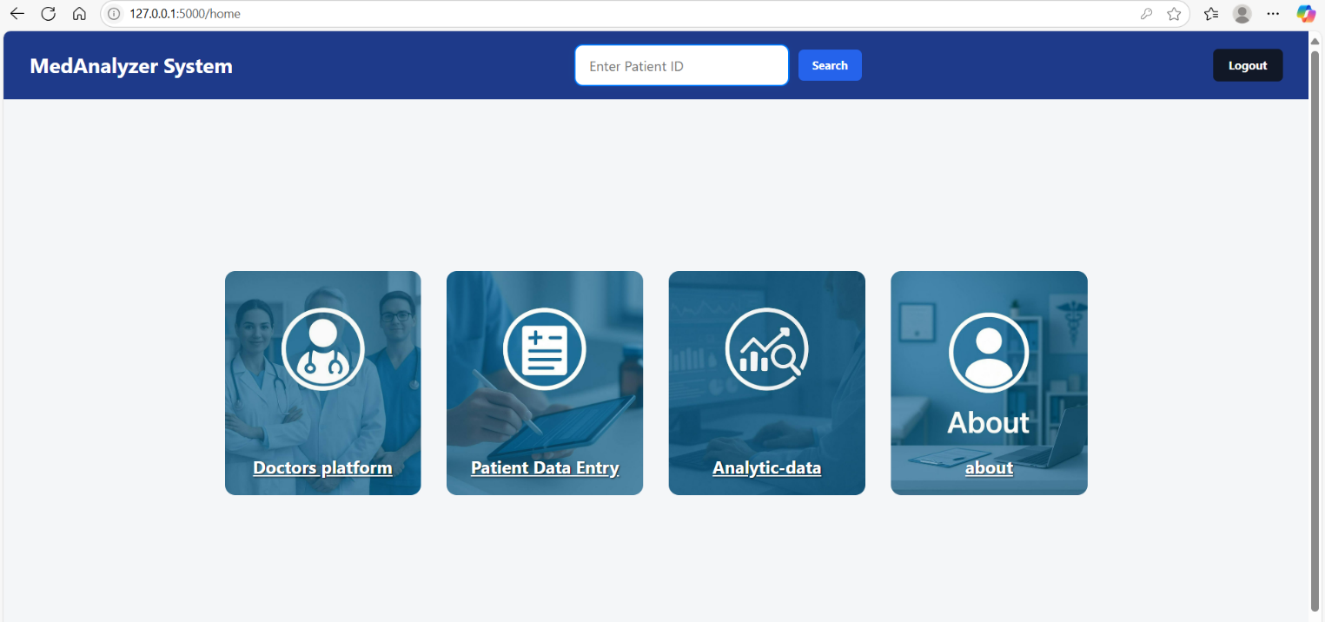
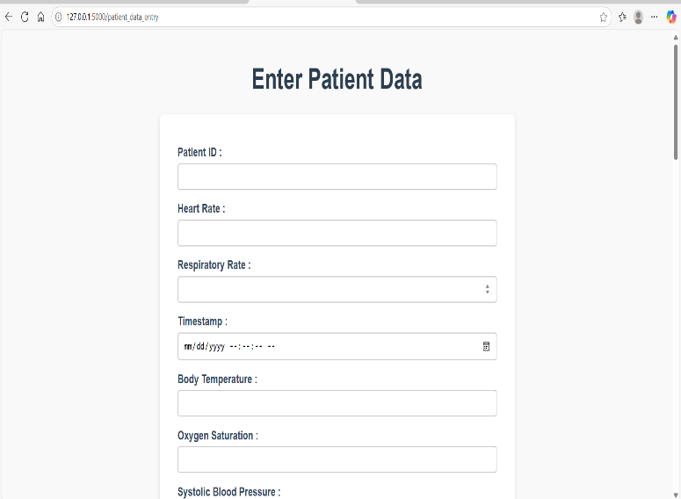
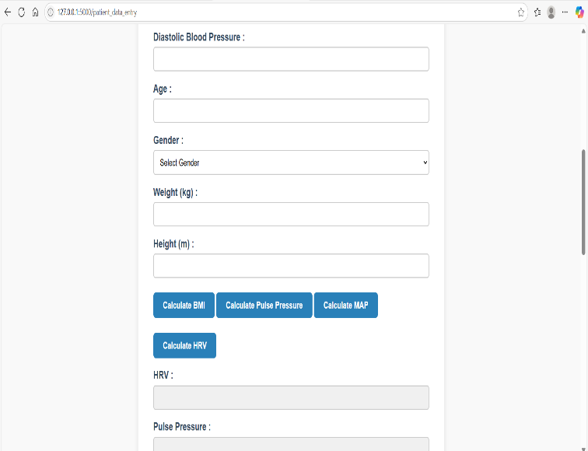
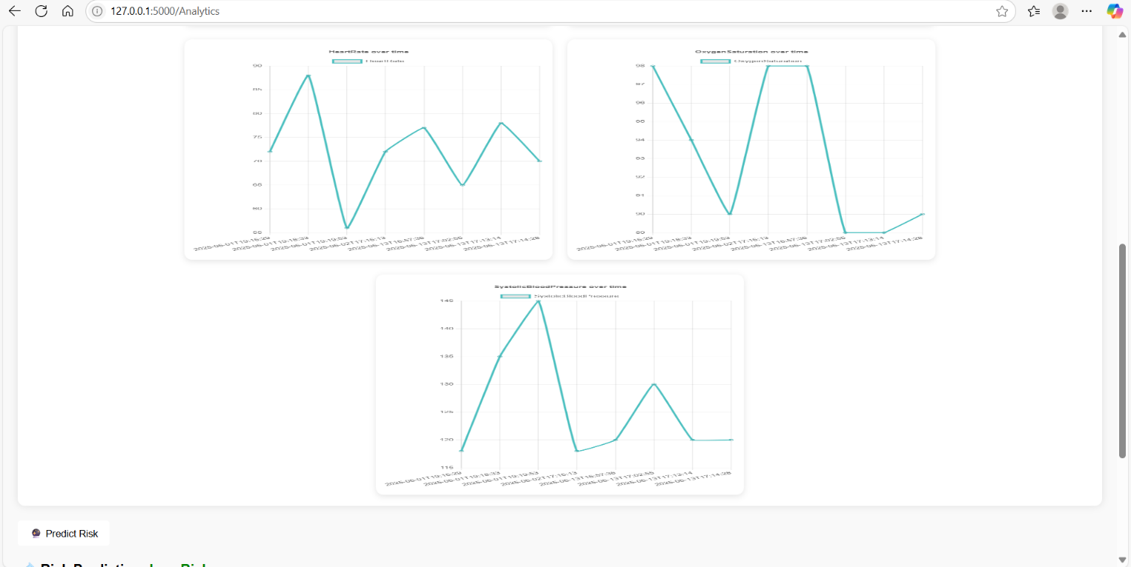
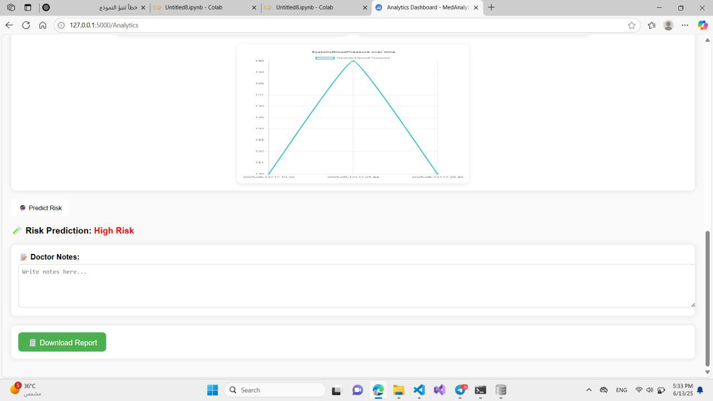
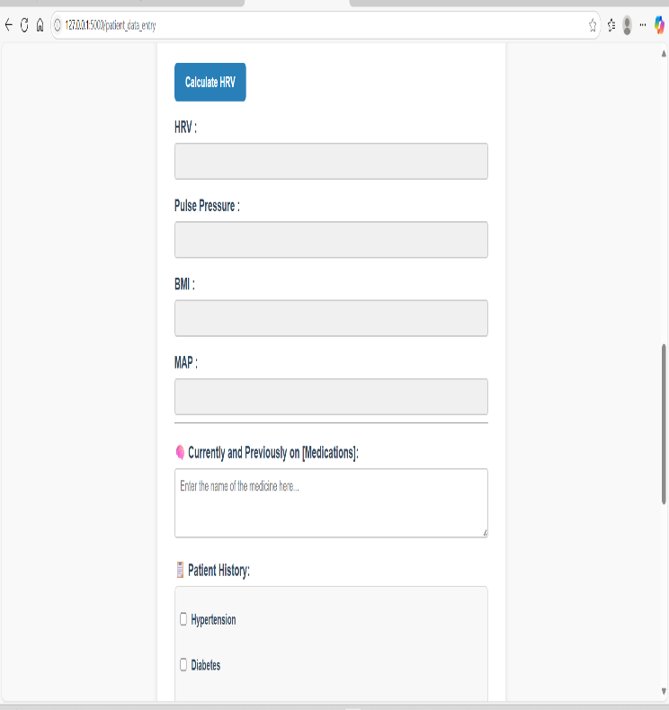
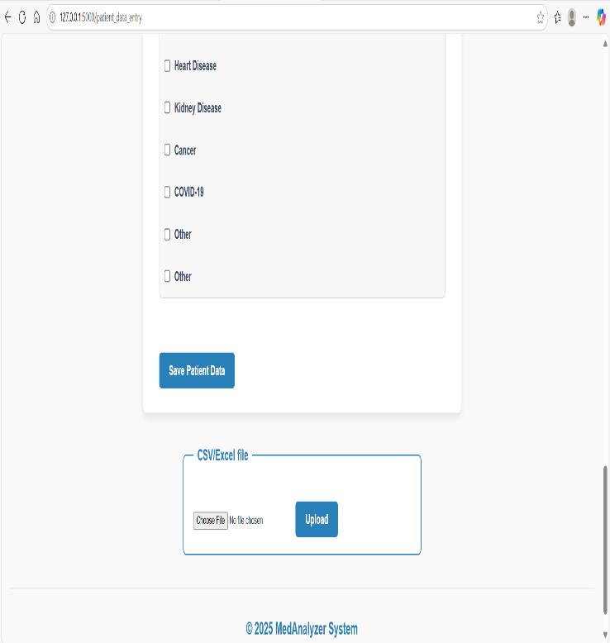
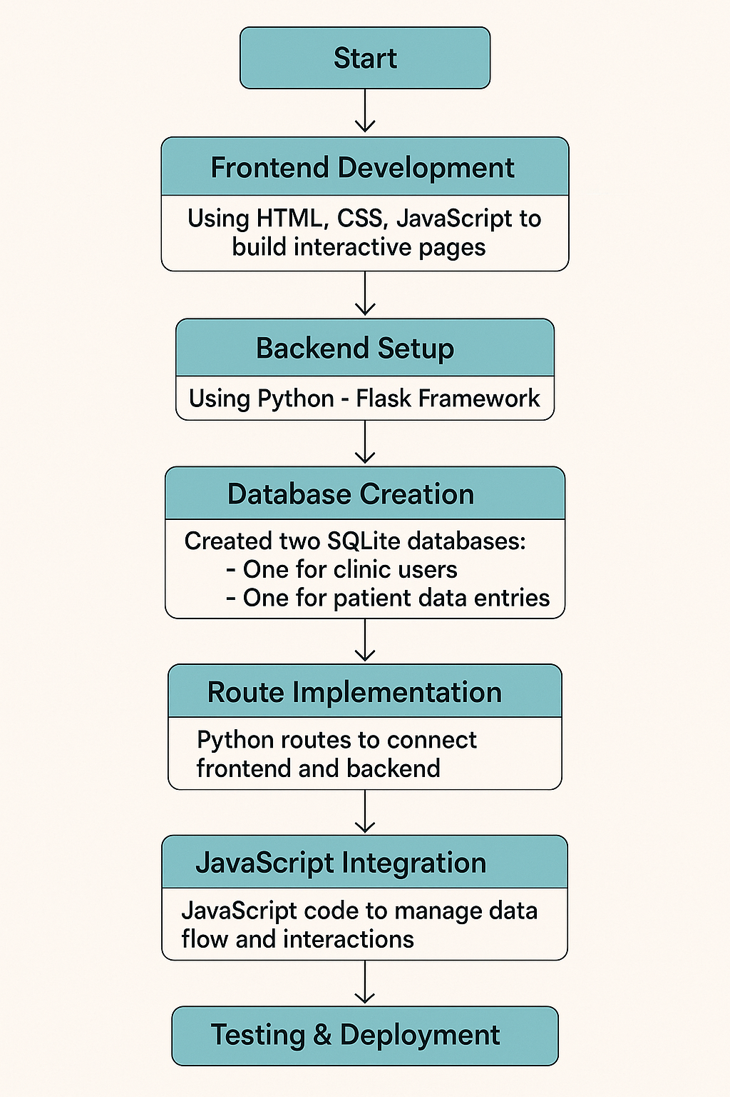
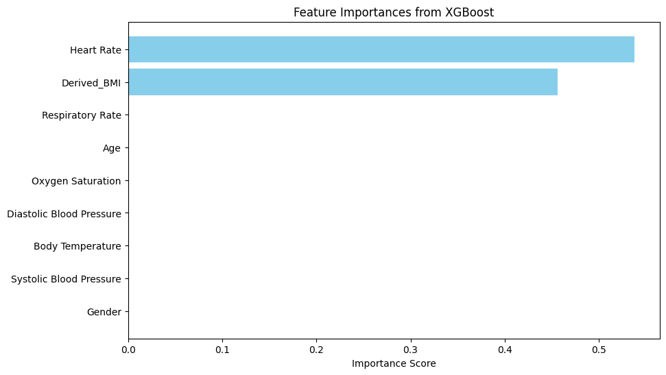
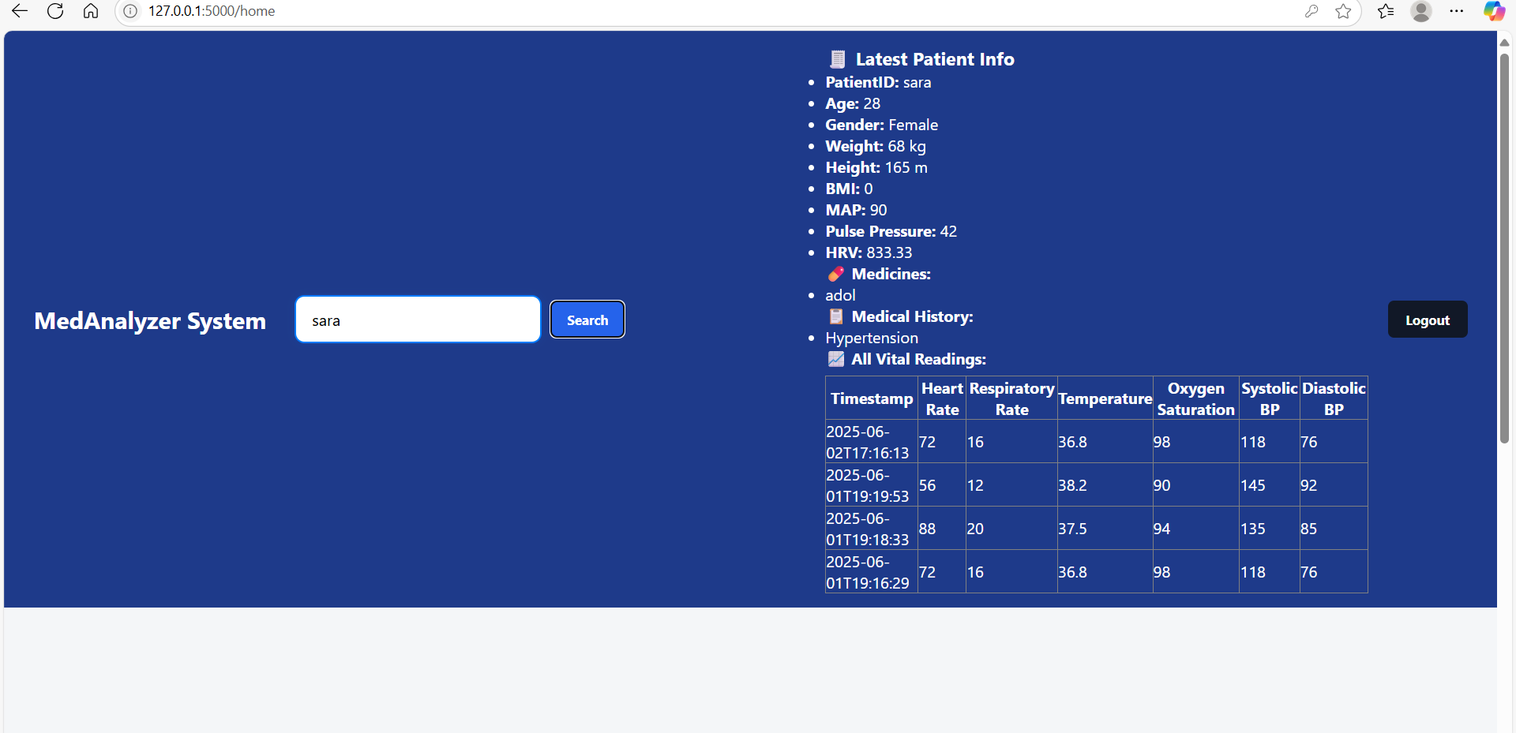
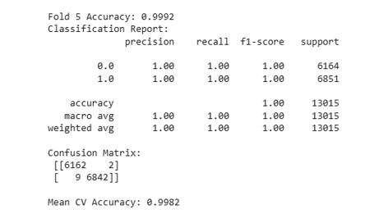
MedAnalyzer: A Python-Based Web Application for Medical Data Analysis and Risk Prediction using Flask and Machine Learning
Students: Sora Ali Mahasneh , Tamara muafaq Malkawi, Amal ayman Alawadi , Deema Atef Bani Khalid
Supervisor: DR Shefaa Tawalbeh
Yarmouk University
Hijjawi Faculty for Engineering Technology
Department of <Biomedical Systems and Informatics> Engineering
Graduation Projects – Second Season 2025
Project Description
Results
The MedAnalyzer project is a comprehensive medical data analysis platform developed to streamline the collection, interpretation, and visualization of vital patient health information. The primary purpose of the project is to assist healthcare professionals in managing patient data efficiently and making informed decisions using intelligent analytics .
Keywords — MedAnalyzer , intelligent analytics , informed decision-making.
Results and Discussion describes results obtained after implementing the MedAnalyzer system.
Login page for the patient role
Dashboard page
Introduction
The need for real-time intelligent medical analytics is a growing field due to the challenges of manual processes and fragmented systems in the healthcare sector. This project aims primarily to develop an easy-to-use system for collecting patient data, predicting risk using machine learning techniques, and interactively visualizing risk predictions, all via the web.
patient Data Entry Page
Analytics Page with The prediction result
Design
Design outlines the technical and structural foundation of the MedAnalyzer system, a web-based medical system for patient information analysis and health threat prediction.
feature importance from XGBoost
Search Box Explanation in the Dashboard Page
xgboost cross validation results
Implementation
CONCLUSIONS
The software for MedAnalyzer was designed as a full-stack application with Flask (Python) performing backend operations and HTML5/CSS3/JavaScript for the frontend, which included a responsive entry interface, visualization, and reporting.
Analytical functionality was imparted by Python libraries, and pre-trained machine learning classifiers , for real-time health risk estimation without runtime training. The entire system operates locally—eschewing cloud dependencies—to maximize data security and offline availability .
the project ultimately achieved its goal of developing a secure web-based application that uses machine learning and enables the applications can ultimately assist patient outcomes as well as medical workflow deliveryprovision of real-time insights that assist in medical decision-making, therefore allowing medical professionals to make quicker, data-based decisions.
To conclude - MedAnalyzer project has shown that the integration of data science with healthcare supportive

